Slide 1
A quick tutorial on igraph

Slide 2
igraph
igraph is an open source collection of libraries for network analysis
  http://igraph.org
Supports: R, python and C
Disclaimer: This tutorial is a very basic tutorial that serves only as an introduction to igraph
  We will focus our descriptions on R, but the usage of the library is very similar to other platforms

Slide 3
Network representation
There are many various ways to represent a network
  Most “popular”
    Adjacency matrix
    Edgelist
    Adjacency list
Adjacency matrix representation is good for mathematical derivations but it is not very efficient for computations especially if networks are sparse
  In a sparse network most of the entries of the matrix will be 0

Slide 4
Network representation
Edgelist
  Store the edges of a network in a tuple format <node ID1, node ID2>
  For example,
1 2
1 5
2 3
2 4
3 4
3 5
3 6

Slide 5
Network representation
Adjacency list
  Easier to work if network is large and sparse
  There is one line for every node in the network that includes the IDs of the nodes he is connected to
  For example, the previous network in adjacency list formaet would be:
1: 2,5
2: 1,3,4
3: 2,4,5,6
4: 2,3
5: 1,3
6: 3

Slide 6
Network representation
igraph supports multiple network representations
  Details of the actual format (e.g., punctuation etc.) might be different for different network libraries
    However, the main format will be the same
Assuming that we have the previous network in an edgelist we can “read” it in igraph
> library(igraph)
> g <- read.graph("sample_net",format="ncol”,directed=F)

Slide 7
Network representation
The network has been read an undirected (UN) and it has 6 nodes and 7 edges
  V(g) gives the nodes of the network
  E(g) gives the edges of the network
> g
> V(g)
IGRAPH UN-- 6 7 --
+ attr: name (v/c)
Vertex sequence:
[1] "1" "2" "5" "3" "4" "6"
> E(g)
Edge sequence:
[1] 2 -- 1
[2] 5 -- 1
[3] 3 -- 2
[4] 4 -- 2
[5] 4 -- 3
[6] 3 -- 5
[7] 6 -- 3

Slide 8
Network representation
You can also get the adjacency matrix
> m <-get.adjacency(g)
6 x 6 sparse Matrix of class "dgCMatrix"
1 2 5 3 4 6
1 . 1 1 . . .
2 1 . . 1 1 .
5 1 . . 1 . .
3 . 1 1 . 1 1
4 . 1 . 1 . .
6 . . . 1 . .

Slide 9
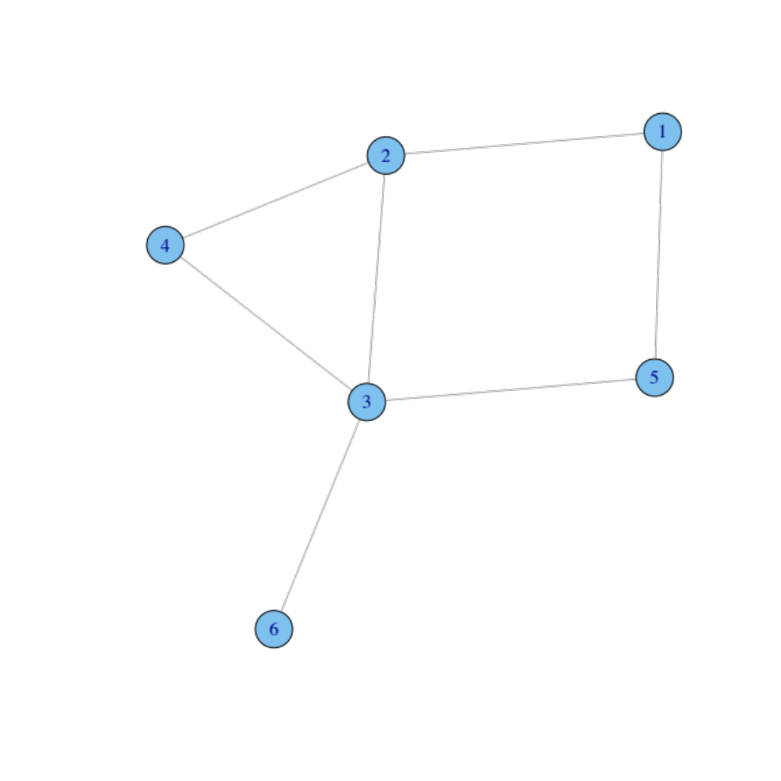
Visualize the network
> plot(g)
plot provides a simple network visualization
  There are more advanced libraries that give more control on the way the network is visualized

Slide 10
Connectance
> graph.density(g,loops=F)
[1] 0.4666667
The argument loops dictates whether to allow loop edges in the graph or not
  If it is true self-edges are considered possible
> graph.density(g,loops=T)
[1] 0.3333333

Slide 11
Node degree
> degree(g)
1 2 5 3 4 6
2 3 2 4 2 1
This provides a list with the degree of every node in the network

Slide 12
Paths
> shortest.paths(g)
1 2 5 3 4 6
1 0 1 1 2 2 3
2 1 0 2 1 1 2
5 1 2 0 1 2 2
3 2 1 1 0 1 1
4 2 1 2 1 0 2
6 3 2 2 1 2 0
shortest.paths provides the length of the shortest path between any two nodes in g
If you want to get the actual paths (and not just their length) you can use the function get.shortest.paths

Slide 13
Paths
We can also get the number of paths of a given length between two nodes by utilizing the adjacency matrix
> m%*%m
6 x 6 sparse Matrix of class "dgCMatrix"
1 2 5 3 4 6
1 2 . . 2 1 .
2 . 3 2 1 1 1
5 . 2 2 . 1 1
3 2 1 . 4 1 .
4 1 1 1 1 2 1
6 . 1 1 . 1 1

Slide 14
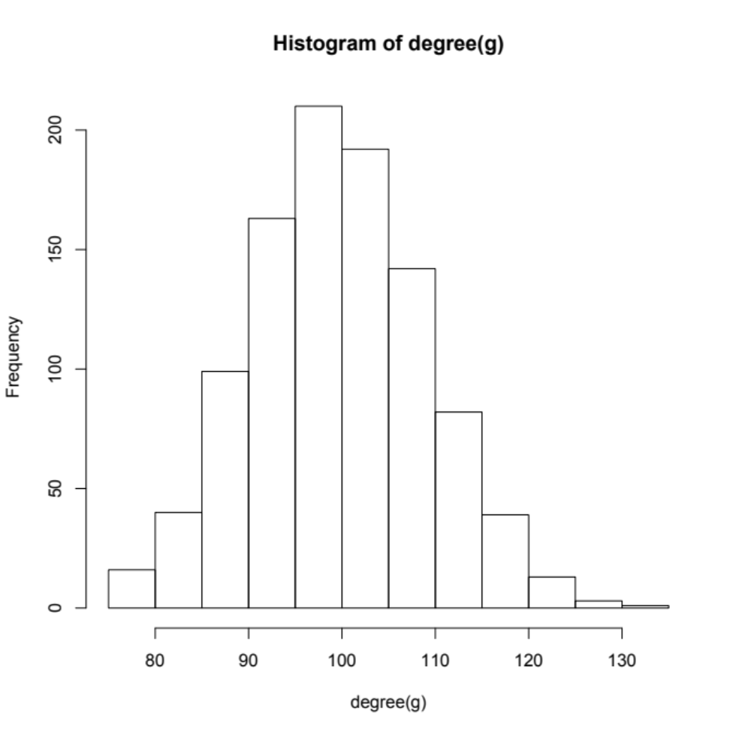
Random graphs
> g=erdos.renyi.game(1000,0.1,type=“gnp”)
> g
IGRAPH U--- 1000 50042 -- Erdos renyi (gnp) graph
+ attr: name (g/c), type (g/c), loops (g/x), p (g/n)
> hist(degree(g))

Slide 15
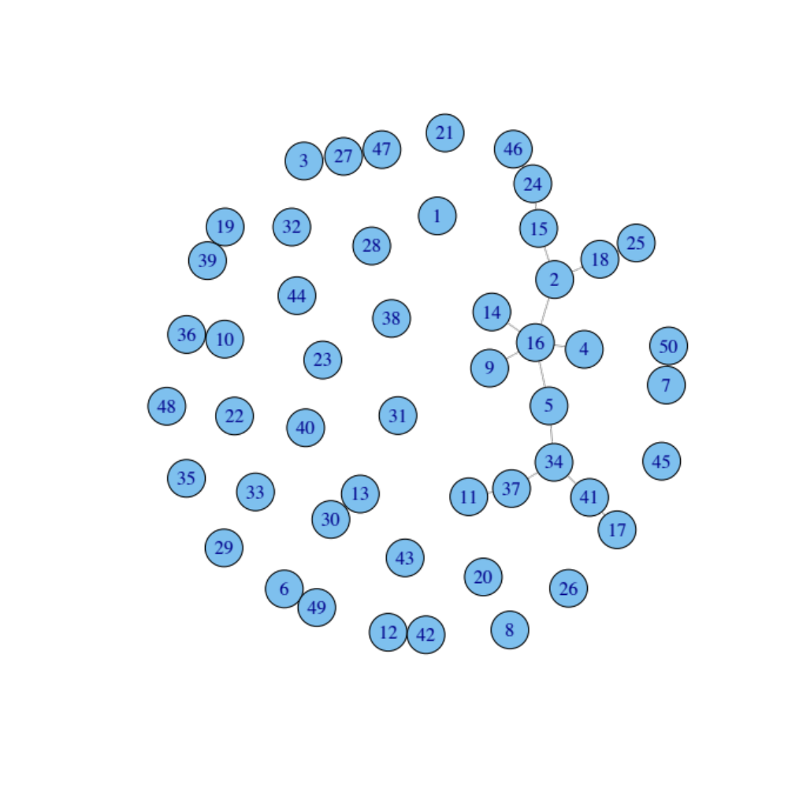
Random graphs
n=50 and p=0.01

Slide 16
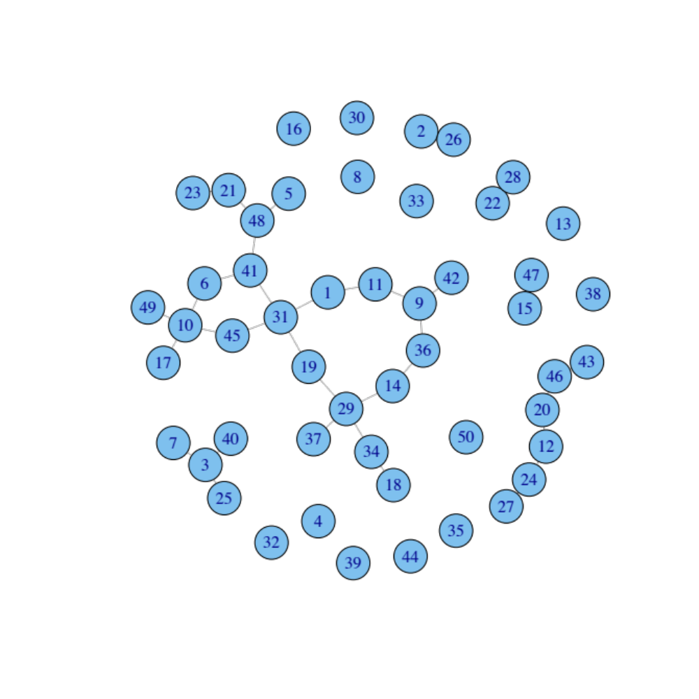
Random graphs
n=50 and p=0.03

Slide 17
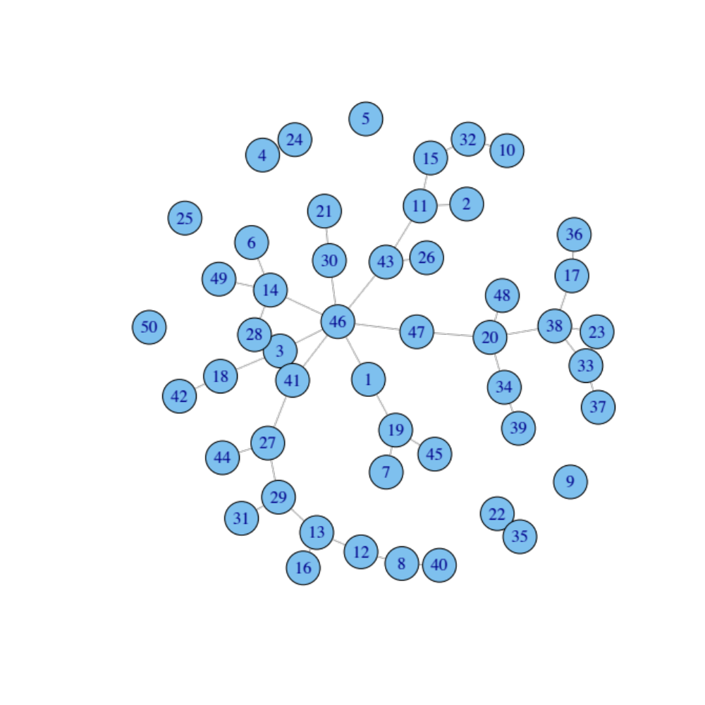
Random graphs
n=50 and p=0.05

Slide 18
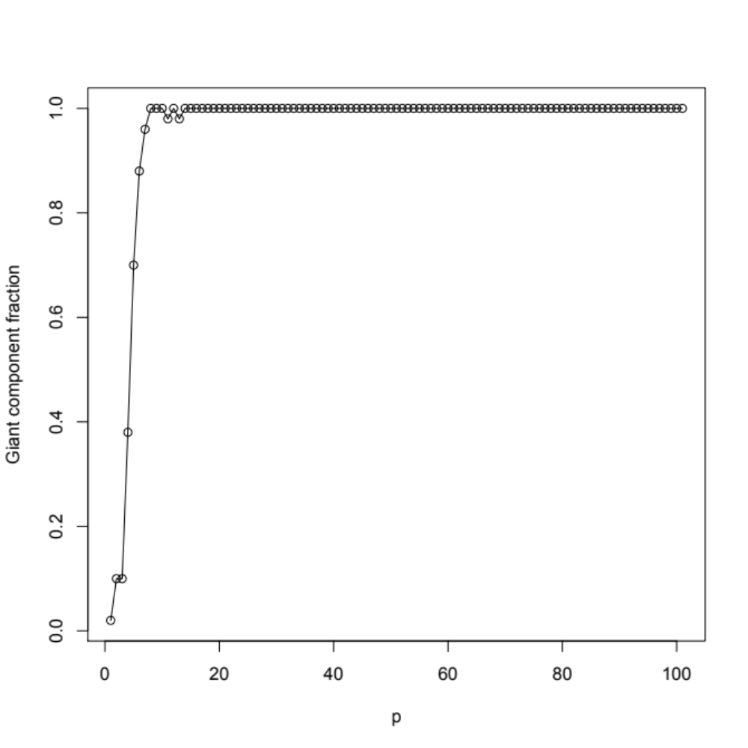
Random graphs
> for (p in 0:100){
g=erdos.renyi.game(50,p/100,"gnp")
s[p+1]=max(clusters(g)$csize)/50
}
plot(s, xlab="p", ylab="Giant component fraction”)
lines(s)

